Slide 1
HOUSE BUILDING COST ESTIMATION WEB SYSTEM CASE OF NICKJOY BUILDING AND CONSTRUCTION COMPANY
NAME: NGAHU NICHOLAS KIRAGU
REG.NO: SCT221-D1-0001/2019
A project report submitted to the department of information technology in the school of computing in partial fulfillment of the requirement for the award of the Degree of Bachelor of science in Information Technology of Jomo Kenyatta University of Science and Technology.

Slide 2
CHAPTER THREE
3.0 SYSTEM ANALYSIS AND DESIGN
3.1 Introduction
This chapter focuses on the system methodology used, the research methodologies, system specifications as well as the logical and physical design of the system.
The methodologies used ensured that the project objective was met accomplishing an interactive web system for Nickjoy building and construction company in terms of estimating the cost of houses for their clients

Slide 3
3.2 Incremental Methodology
This approach interleaves the activities of specification, development, and validation. The system is developed as a series of versions (increments) with each version adding functionalities to the previous one.
Incremental model is based on developing an initial implementation, which is exposed to the user and several versions created or developed based on user’s response.
Each increment or version of the system includes some of the functionalities that are needed by the user.
The early stages increments of the system contains the most urgently required functionality meaning that the customer can evaluate the system at a relatively early stage in the development to see if it delivers what is required

Slide 4
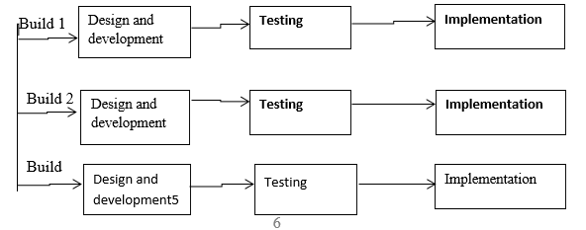
Incremental model

Slide 5
3.3 REQUIREMENT ELICITATION
DATA COLLECTION PROCEDURES
The data used in this approach came from both primary and secondary sources.
3.3.1 Primary sources
I Interviews-Engineers and architectures were intervieved on how the bill of quantity is being done using the current system and the challenges encountered while using the current system .
Observation-The researcher observed the staff of Nickjoy building and construction company as they executed their duties and he got the required data.
Questionnaires-Published questions were given to the respondents/staff of the company to be answered in either yes or no format. The respondents who in this case were the architects and quantity surveyors and engineers provided the necessary guidance by providing the best information which helped the project achieve the goal
3.3.2 Secondary sources
Secondary data were gathered in the course of the study which contained the collected as well as the analyzed past data from both printed and unprinted resources that were utilized to indicate the existence of an event from previous times and offer support to the data from primary sources. Secondary sources contained former hypotheses newspapers, journals, books, periodicals and government and local government publications.

Slide 6
3.3.3 Data Collection Instruments
3.3.4Interviews
Interviews were conducted to obtain comprehensive facts about matters that were either too complex or delicate to include in the questionnaires. Interviews were done in a face-to-face manner using specific present property agents and contractors.
3.3.5 Direct observation
Direct observation is a simple method that allows the project team members to physically observe information that cannot be covered in the interview session or others. It was used where there are communication difficulties like the language barrier where the respondents were unable to express themselves fully to the researchers.
3.3.6 Questionnaires
The research team provided the published questions to the respondents to be answered in either yes or no format. The respondents who in this case were the architects provided the necessary guidance by providing the best information which helped the project achieve the goal.

Slide 7
3.4 Data and System analysis
Data analysis is the process of examining, cleaning, converting and displaying data with the aim of determining valuable information, to make conclusions and to support decision-making.
Upon collection of data, it is checked if it is complete and made ready for analysis. The data from the field is coded in accordance to the subjects under study.

Slide 8
Table 4 Time taken to estimate cost of a house
Staff Category | Approximate Time taken to analyze materials required(Hours) | Approximate Time taken to estimate cost of the building(Hours) | Total
A | 24 | 20 | 44
B | 22 | 18 | 40
C | 25 | 22 | 47

Slide 9
3.5 System specification After analysis of the collected data, the following system specifications were realized
System administrator requirements
An effective way to view all users
An effective way to manage users accounts
An easier way to manage house materials
An effective way to manage house costs
Users requirements
An efficient way to create a new account
An effective way to analyze the house
An easier way to view the cost

Slide 10
3.5.2 Functional Requirement
The new system should be able :
To Create a log in account
To enter the dimensions of the building
To analyse the quantity of the material required based on the dimensions entered
To compute bill of quantity

Slide 11
3.8 System Design This section provides both physical and logical designs of the system
3.8.1 Logical design
The main function of the new system is to assist in automating the estimation of house building cost
The system flowchart below illustrates how the new system works

Slide 12
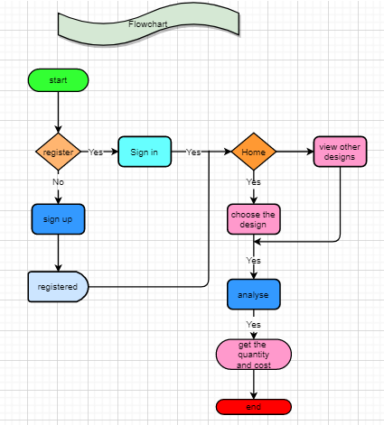
Flowchart illustrating how the new system works

Slide 13
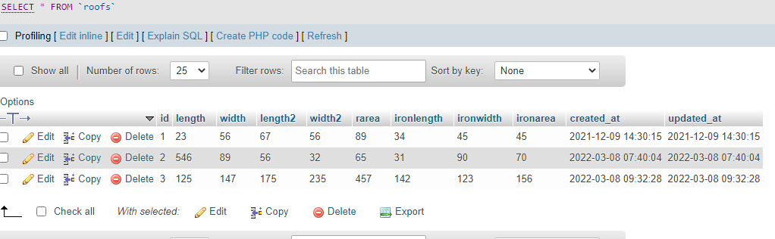
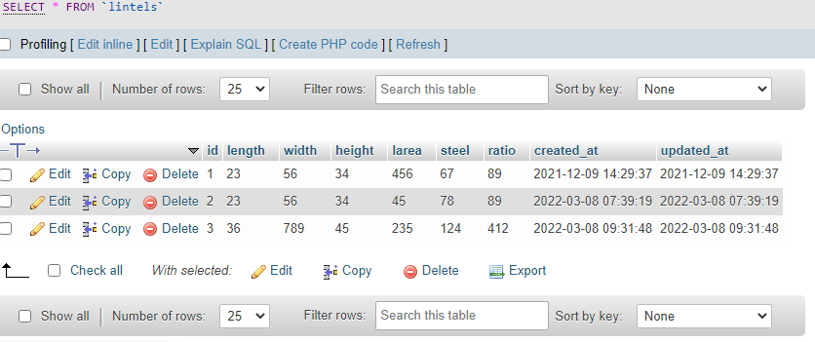
3.9 Physical design Database design
Roof table
Lintel table

Slide 14
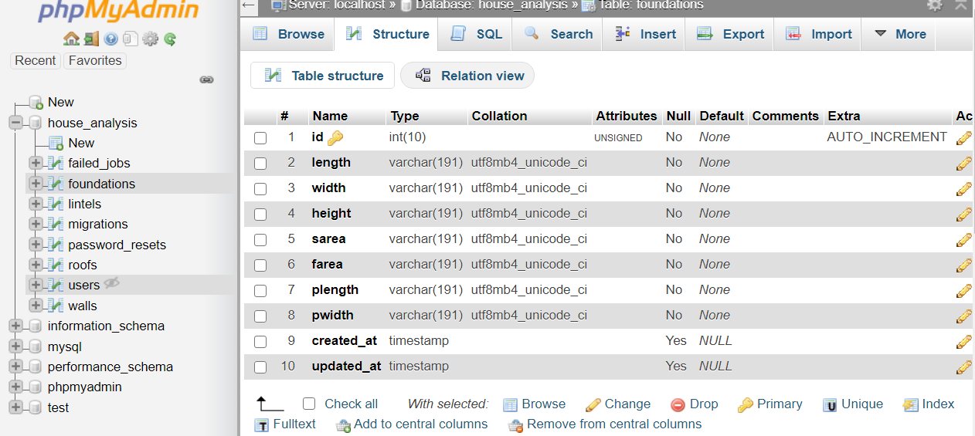
3.8 System Architecture

Slide 15
User Interface Design
User Interface (UI) Design focuses on forestalling what users might need to do thereby ensuring that the interface has elements that are easy to access, understand, and use to facilitate those actions. UI makes concepts from interaction design come together, visual design and information architecture. The user interface design type here was graphical user. The register, login allows the user to access the system with full rights.
The register interface enables the user to register into the system with their name, email address and password as well as the password confirmation. The register details are then submitted to the user table of the database to enable the user to effectively login to the system using the login interface as shown.

Slide 16
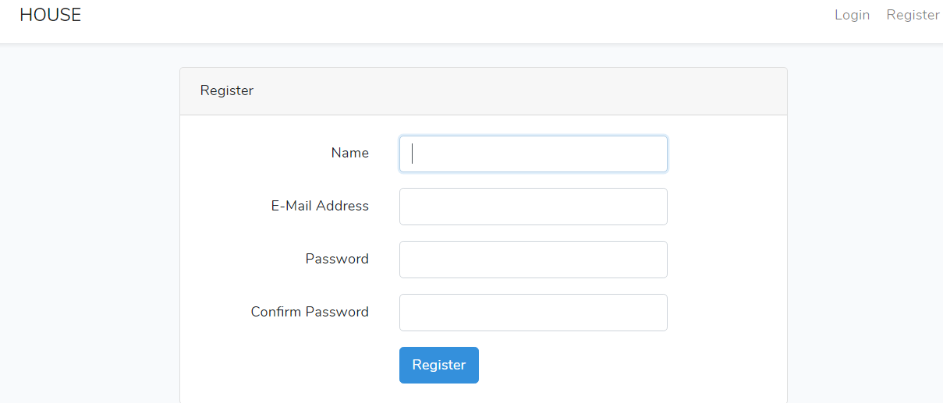
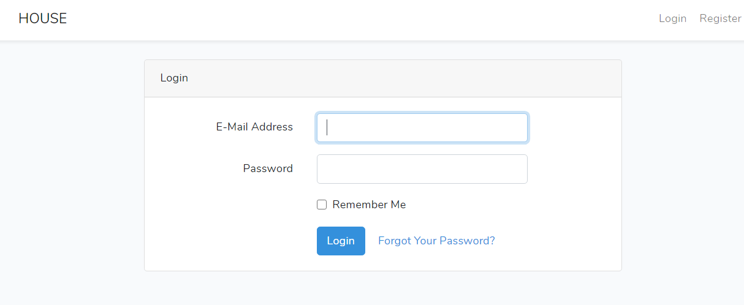
Login interface

Slide 17
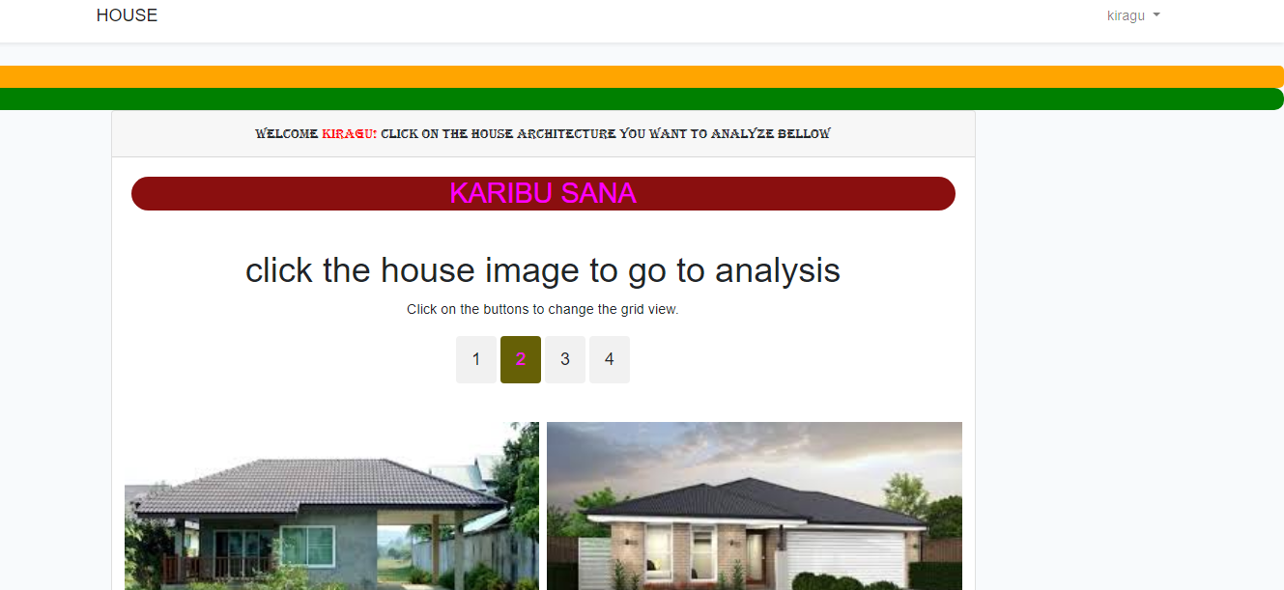
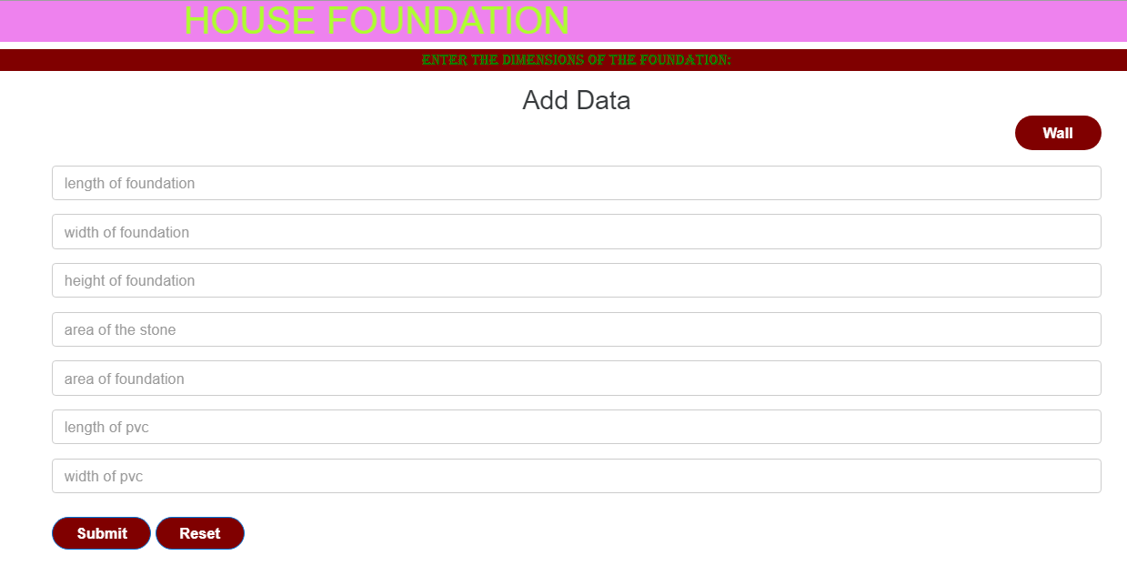
Interface

Slide 18
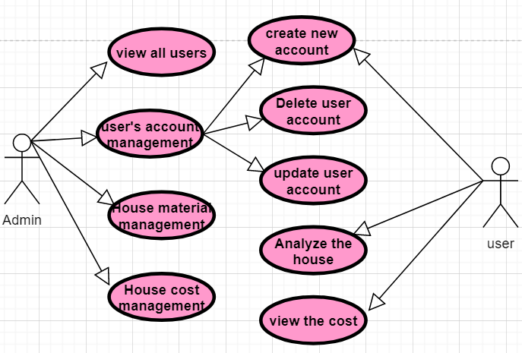
Use case Diagram Below is the general use case that shows the system users and their assigned privileges. The administrator can execute every process in the system; while a standard user is only limited to a few roles as shown

Slide 19
Flowchart

Slide 20
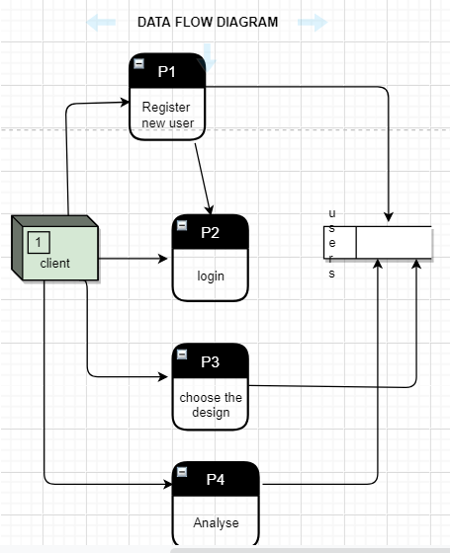
Data flow diagram

